Slide 1
The UK Marine Pollution Preparedness and Response

Slide 2
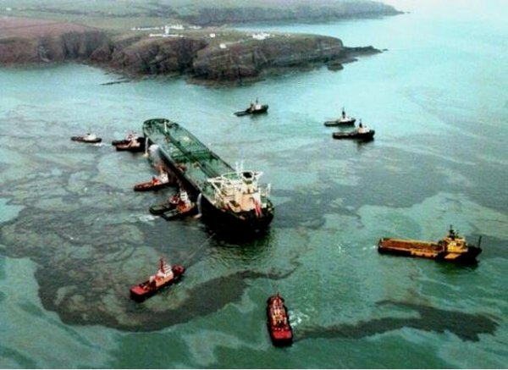
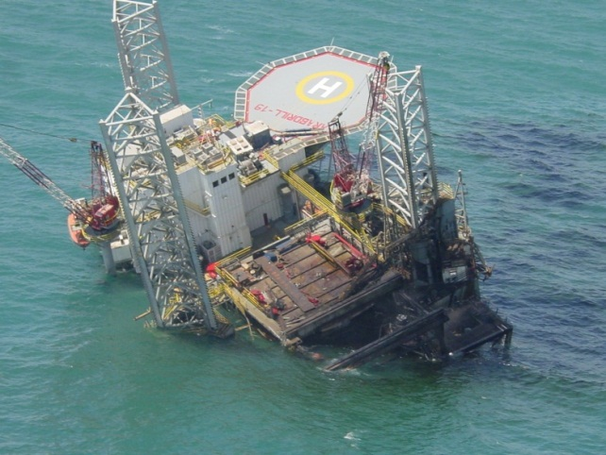
Scope
Why: Pollution Prevention, Preparedness and Response
How: Contingency Planning and the National Competent Authority
Who: MCA Counter Pollution and Salvage
  Roles and Responsibilities
  Surveillance & Alerting
  Responding
  Incident Management
  The Marine Response Centre
The Environment Group

Slide 3
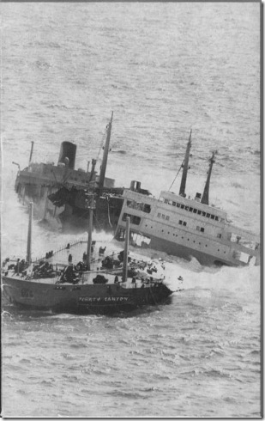
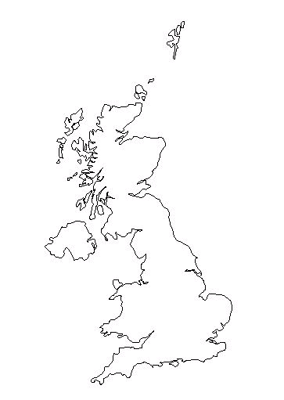
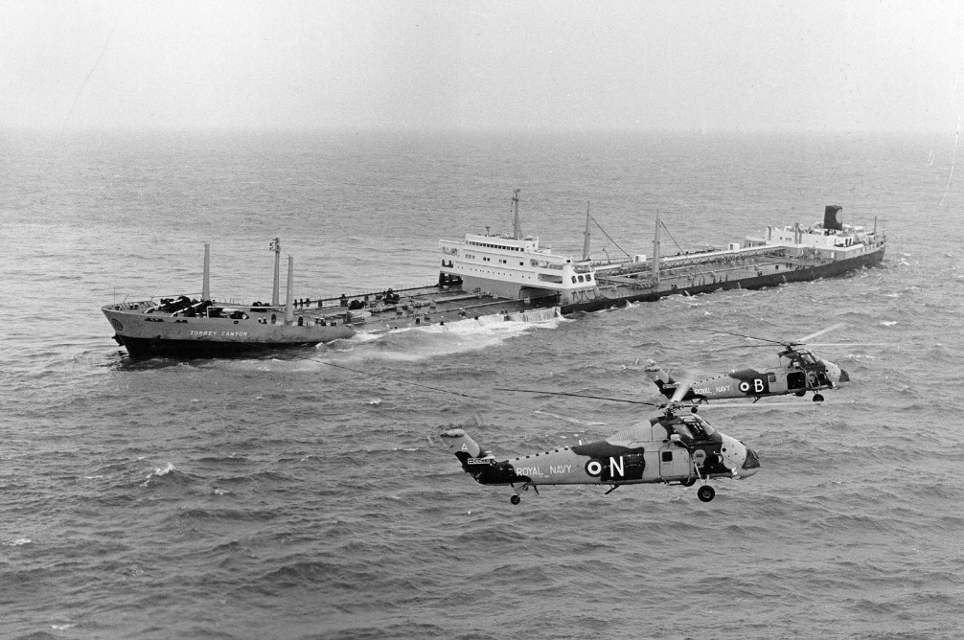
Torrey Canyon
18 March 1967
Enroute to Milford Haven
Struck Pollards Rock, Seven Stone Reef, Isles of Scilly
Spilled 119,000 tonnes crude oil
Response was a shambles

Slide 4
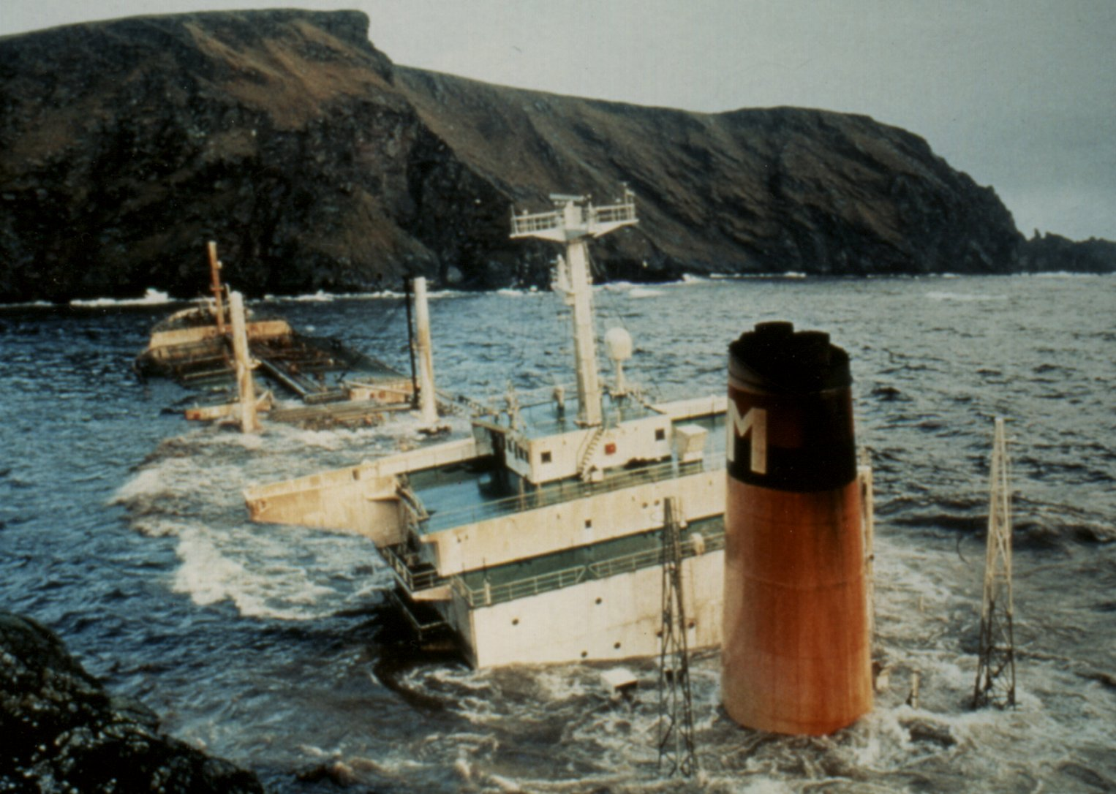
Braer
5 January 1993
Enroute to Quebec
Suffered engine failure
Grounded at Quendale, Shetland Islands
Spilled 85,000 tonnes Gulfax crude oil

Slide 5
Sea Empress
15 February 1996
Enroute to Milford Haven
Spilled 72,000 tonnes crude oil
Calm conditions
Harbour Pilot on board

Slide 6
International Conventions
Two Key Conventions designed to protect the marine environment from pollution
  The International Convention for the Prevention of Pollution from Ships 1973, (the “MARPOL Convention”) as amended (Protocol of 1978):
    Aims to:
    control pollution of the sea by oil, chemical and other harmful
    substances that might be discharged during the course of a ship’s operations
    or when a ship is damaged,
    places limits on discharge levels,
    obliges its signatories to inspect ships in port and at sea,
    trace and prosecute polluting ships and,
    ensure that there are adequate port facilities for receiving waste from ships

Slide 7
International Convention
  The International Convention on Oil Pollution Preparedness, Response and Co-operation 1990 (the "OPRC Convention")
    Obliges signatories to inspect ships, maintain a national contingency plan for
    responding to oil pollution incidents, have available and maintain appropriate
    equipment, conduct training and exercising and provide technical assistance to
    other signatories in the event of such incidents.
    Ports and harbours, ships and offshore installations are required to have their own
    approved oil pollution contingency plans and to report pollution incidents when
    they occur.
    They, and signatory governments, must put in place equipment for combating
    incidents, hold training exercises and have communication facilities to allow them
    to respond without delay to pollution incidents.

Slide 8
National Regulation and Guidelines
Under the Merchant Shipping Act, the government has issued Statutory Instruments (Regulations) to implement these conventions, the main ones are:
  The Merchant Shipping (Oil Pollution Preparedness, Response and Co-operation Convention)
  The Merchant Shipping (Port Waste Reception Facilities)
  The Merchant Shipping (Prevention of Oil Pollution)
  The Merchant Shipping (Ship to Ship Transfers – Oil Cargo and Bunkers)
Offshore Installations (Emergency Pollution Control)
OPRC Guidelines for Ports, Harbours and Oil Handling Facilities
Places of Refuge
Civil Contingencies Act
Claims and Cost Recovery

Slide 9
Legacy/Dormant EU Legislation
EU Directive 2002/59/EC - VTMD and Places of Refuge
EU Directive2013/30/EC – The Safety of Offshore Oil and Gas Installations:

Slide 10
UK Strategic Overview
The Secretary of State for Transport has overall responsibility for taking or co-ordinating measures to prevent, reduce and minimise the effects of marine pollution.
MCA is the National Competent Authority for OPRC in the UK and is tasked to:
  minimise the risk of pollution from ships and offshore installations,
  where pollution occurs, minimise the impact on UK waters, coastlines and economic interests.
  takes the lead in pollution at sea from ships

Slide 11
UK Strategic Overview
The ‘Offshore Petroleum Regulator for Environment and Decommissioning (OPRED)’, on behalf of BEIS, has the responsibility for offshore oil & gas environmental policy.
  offshore infrastructure environmental inspections
  incident investigation
  review applications and issue environmental permits and consents
  review and approve Oil Pollution Emergency Plans

Slide 12
Counter Pollution Operations in UK
Port / Harbour Authorities, Oil Handling Facilities ashore, Owners and Masters of ships have a statutory responsibility for ensuring they do not pollute the sea and for the clean-up of pollution they have caused.
A Harbour Master or other individual having charge of a harbour, and any individual having charge of an oil handling facility (except those which are pipelines), who observes or is made aware of any event involving a discharge of or probable discharge of oil, or the presence of oil in the sea shall without delay report the event, or the presence of oil, as the case may be, to HM Coastguard.

Slide 13
Counter Pollution Operations in UK
Local Authorities have a statutory duty to plan for, or carry out, shoreline clean-up.
In addition as Cat 1 Responders they are to:
  assess the risk of an emergency occurring
  Make business continuity arrangements
  Conduct emergency planning
  Inform, warn and advise the public
  Cooperate in resilience activities
  Share information

Slide 14
Responsible Areas

Slide 15
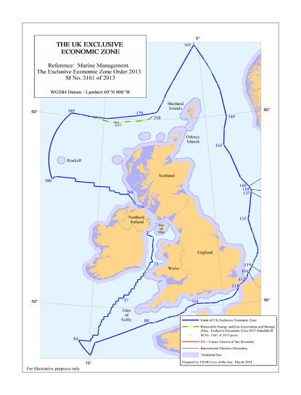
UK Exclusive Economic Zone
Includes the UK’s internal
waters.
Extends to 200 nautical miles
from the coastline or to the
nearest median line with
neighbouring coastal states.
c.17,000 km of coastline
Sea Area > 773,000 sq km

Slide 16
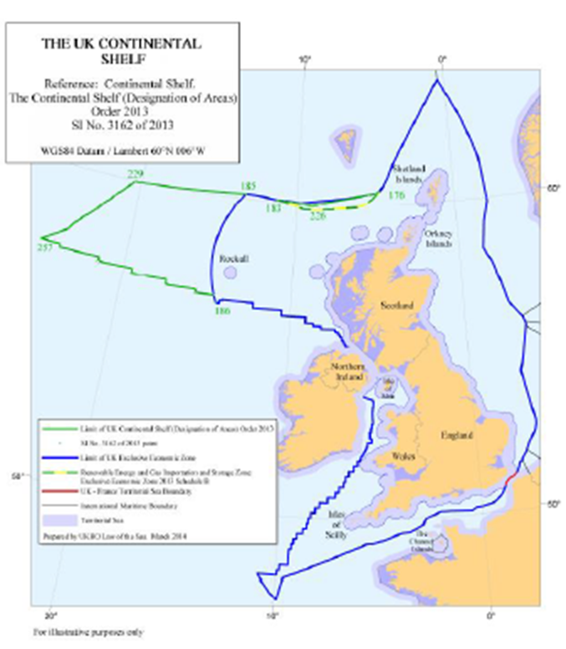
UK Continental Shelf

Slide 17
The Risk

Slide 18
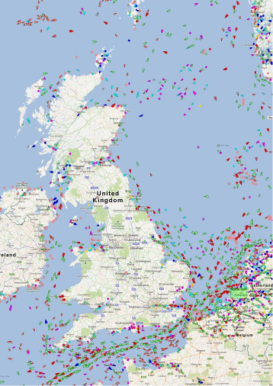
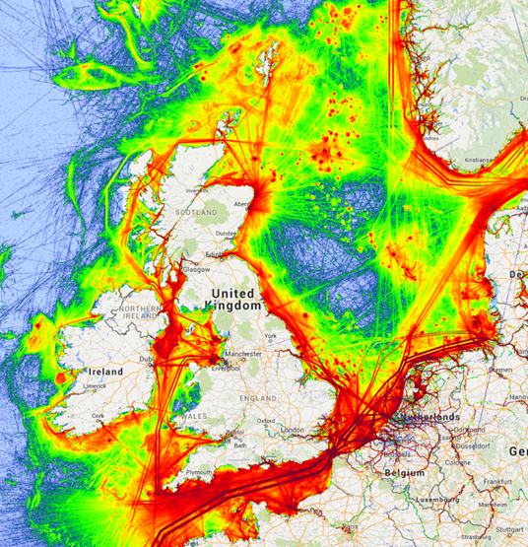
The Threat/Risk

Slide 19
Shipping Types

Slide 20
Offshore Oil and Gas Installations
Summary | Installations
Number of Oil Platforms | 89
Number of Oil Floating Installations | 21
Total Number of Oil Installations | 110
Total Number of Gas Platforms | 187
Total Number of Oil and Gas Installations | 297

Slide 21
Contingency Planning

Slide 22
Why do we need Contingency Plans ?
Prepares to respond to an anticipated risk, crisis or emergency.
Spring-board for a more timely, efficient and effective response, thus mitigating public health, environmental and socio-economic impact.
No time to plan during crisis management.
Identifies wide variety of pre-existing specialised skills, services and equipment.
Framework for training and exercising
  Instills confidence in the responders and public.

Slide 23

Lack of Planning – the consequences
Initial confusion
Lack of initial direction
Slow response
Costly mistakes
Worsening of the incident - greater impact
Hazards to the public and environment
Lost business and credibility

Slide 24
Fundamental Considerations
Statutory and legal considerations
Government policies
Council policy
Ownership of vessel or facility
Ownership of pollutant
Joint interests
Who is responsible
Who cleans up and pays

Slide 25
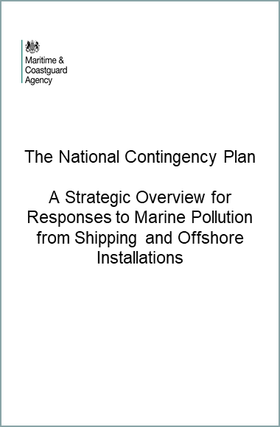
National Contingency Plan
As a Party to the UN Convention on the Law of the Sea (UNCLOS) and signatory to OPRC, the UK has an obligation;
‘to protect and preserve the marine
environment.’
A strategic document that is one of the measures the UK has taken to meet this obligation.
Purpose is to ensure that there is a timely, measured and effective response to incidents.
The MCA are custodians of the plan, currently under review.

Slide 26
Purpose of the UK NCP
Provide guidance on:
  The legal basis for response and area of responsibility,
  Role and responsibilities of response organisations,
  Incident initiation, response levels of response and escalation,
  General incident management, coordination and communication,
  General resources that may be brought into play and the circumstances in which the MCA deploys the UK’S national assets to respond to a marine pollution incident in order to protect the overriding public interest.

Slide 27
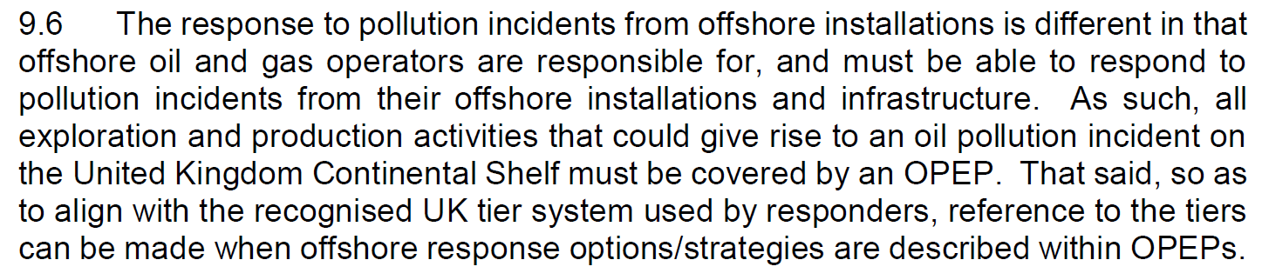
Oil and Gas Industry
CP Responsibility

Slide 28
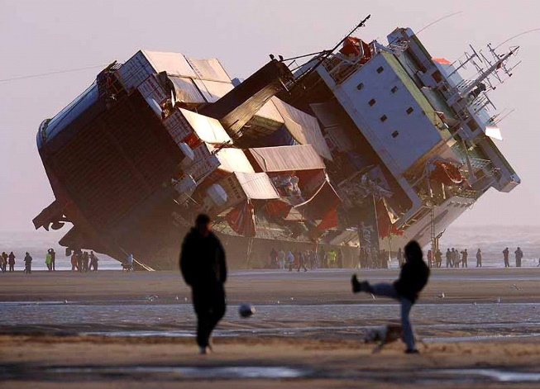
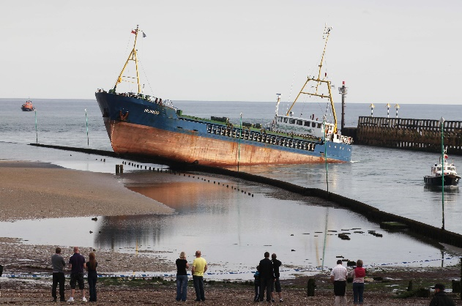
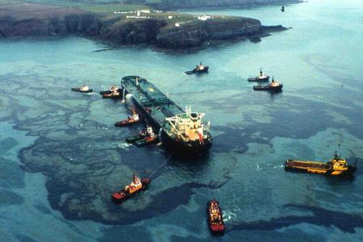
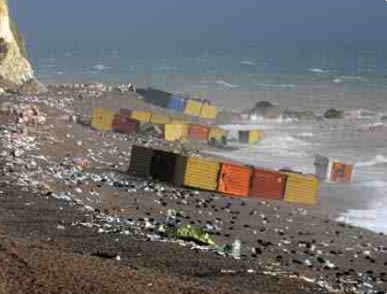
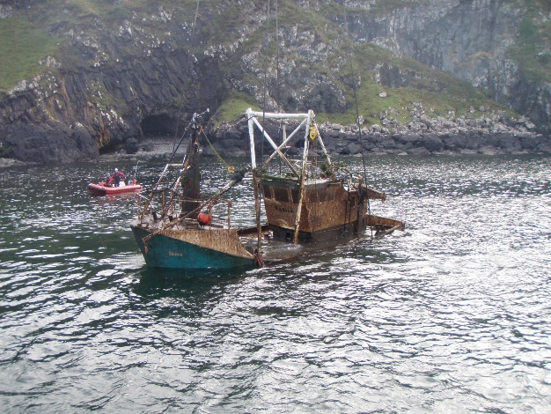
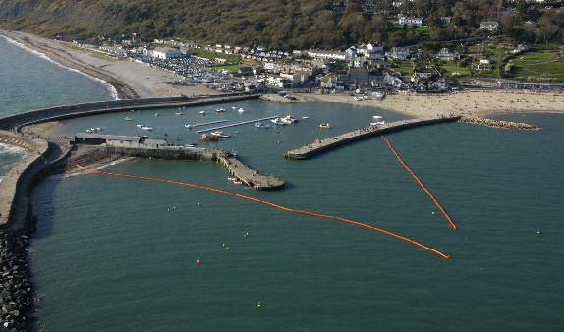
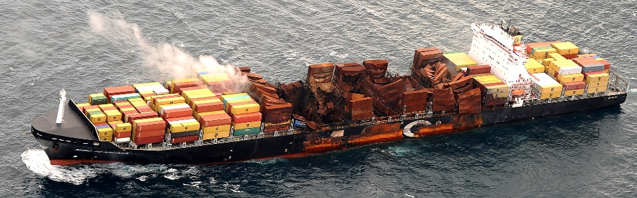
Who needs Contingency Plans?
Bonn Agreement
UK - Irish MOU
International Accords
National Authority
County Authority
Port or local Authority
Co-ops
Potential Spiller
Notes:
Ship or Oil Handling Facility
///
Co-ops – Clearwater Forth, Clyde Clean, those which group individual plans together
////
Individual Ports, Harbours and local authorities
////
Lothian, Grampian, Argylle & Bute
////
UK and other Countries
////
International agreements and co-operation plans

Slide 29
Tiered Response
Tier 1 (Local Response)
  Small operational type spills that may occur within a location a result of daily activities.
  The level at which a response operation could be carried out successfully using individual resources and without assistance from others.
    i.e. Within the capability of the polluter, one local authority, harbour authority or the Operator - on-site
  NCA advice and resources available if requested
Notes:
It should be remembered that what may be a Tier 1 spill for one port/harbour may be considered a Tier 2 spill for another, each individual harbour will be different following their risk assessment.
Talk through briefing each one
OPRC Plans must cover each of the tier levels and how to escalate from Tier 1 to Tier 3 and back

Slide 30
Tiered Response
Tier 2 (Enhanced Response)
  A medium sized spill within the vicinity of a company’s location where immediate resources are insufficient to cope with the incident and further resources may be called in on a mutual aid basis.
  A Tier 2 incident may involve Local Government.
  Beyond the capability of the polluter, one local authority or harbour authority.
  T1 - capability overwhelmed
  Commercial Oil Spill Response Contractors mobilised.
  NCA advice and resources available if requested
Notes:
It should be remembered that what may be a Tier 1 spill for one port/harbour may be considered a Tier 2 spill for another, each individual harbour will be different following their risk assessment.
Talk through briefing each one
OPRC Plans must cover each of the tier levels and how to escalate from Tier 1 to Tier 3 and back

Slide 31
Tiered Response
Tier 3 (National Response)
  A large spill beyond the capability of both local and regional resources, and where substantial further resources are required.
    T2 capability overwhelmed
    National resources required
  Support from a national (Tier 3), Regional/International cooperative stockpile may be necessary.
  An incident that requires national assistance through the implementation of the National Contingency Plan and will be subject to Government controls.
  The NCA will Lead

Slide 32
Tier Level Determination
Not necessarily on oil type or spill volume.
  Location ?
  Risks/potential impacts:
    Public health / Environmental /
    Socio-economic
Complexity:
  Response variables
  Nature of coastline
  Port/Harbour or Facility importance – CNI ?
  Scale of resources required.
Notes:
Type of operations being conducted at the port/harbour, vessels size type cargoes, bunkering conducted, tidal rates etc
The number and type of resources to deal effectively with a spill – especially Tier 1
Determination is not solely on the quantity or type of oil spilled, different oils, different characteristics

Slide 33
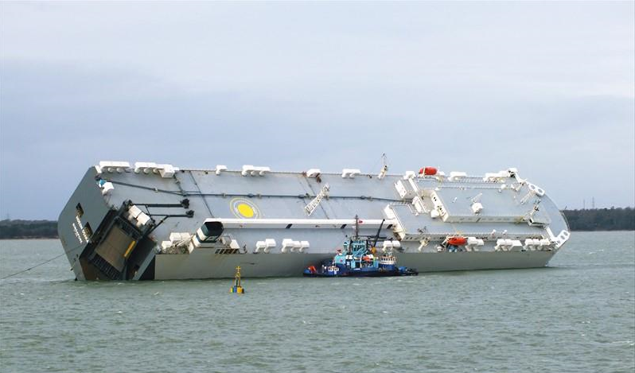
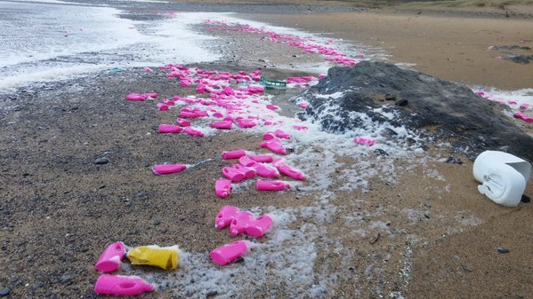
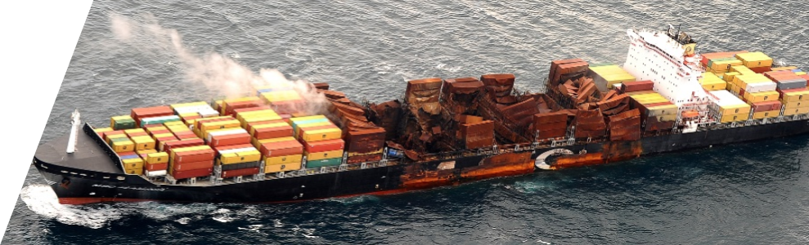
MCA Counter Pollution & Salvage

Slide 34
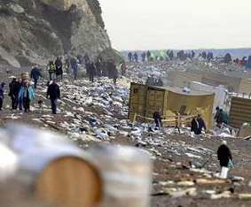
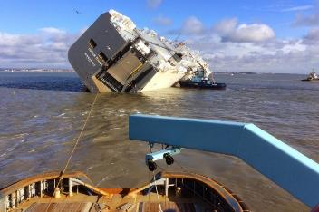
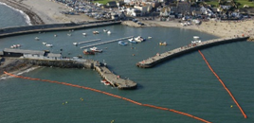
MCA Counter Pollution and Salvage
CPS is both Nationally and Regionally based with central operational, technical and scientific support including mariners, scientists, logistics and cost recovery support specialists in the MCA’s HQ in Southampton.

Slide 35
SCOPE AND PURPOSE
Prevention, Preparedness & Response
‘Tiered’ Response, as defined in NCP
Mobilisation of Resources (National and International)
Waste Management
Claim/Cost Recovery
Prosecution
  International Conventions
  & National Legislation
    Navigation and Routeing of Vessels
Standards of Ship Construction,
Equipment and Operation
  Survey and Inspection
  Enforcement
RESPONSE
PREVENTION
PREPAREDNESS
Oil Spill Contingency Planning
Training & Exercises
Surveillance
Provision of Personnel and Resources
International Co-op and Support

Slide 36
CPS Core Structure
Head of Counter
Pollution & Salvage
Stan Woznicki
Policy Support
TBC
CPSO West
Environmental
Resource & Claims
CPSO East
CPSO North
Science Lead
Lead
Andrew Healy
Jayne Ede
John Woollam
Neil Chapman
Jerry Connors
Environmental
Resource & Claims
CPSO Scotland
CPSO N & W Isles
Science (HNS)
Support
& NI
tbc
Emily Dragon
Gary Spark
Paul Tunstall
Environmental
HMCG (Ops) - Regional liaison, port and harbour OPRC plans, monitoring, training and audit
Scientist Advisor
Hazel Christie
HMCG (Gov) -
Stockpile management, incident logistics and claims
HMCG (Pol) - Env Science, technical and modelling

Slide 37
Counter Pollution Roles
4 Broad Strands of Activity:
  Policy and Regulation Management
    NCA and Owner of the ‘National Contingency Plan’
    International and National liaison/stakeholder
    engagement:
      Inter Government Department
      Bonn Agreement + Mancheplan, NORBRIT and other
      Bi-Lat Plans,
      EU/EC/EMSA – Offshore Safety & Pollution, VTMD, Places of Refuge et al
      IMO
      MMO/NRW/Marine Scot, EA & SEG, Wildlife NGOs

Slide 38
Counter Pollution Roles
  Policy and Regulation management (Continued)
    Port/Harbours & Oil Handling Facilities - OPRC Planning Guidance, Assessment and Audit
    Accreditation of OPRC Trainers and Responders
      In co-operation with Nautical Institute as Auditor
      Linked to IMO Levels of training
      Minimum training requirements for Ports and Harbours
    Local Authority Contingency Planning – advisory
    Offshore OPEP Assessment – support to OPRED
    Claims management and Cost Recovery

Slide 39
Counter Pollution Roles
  Operations Management:
    24/7 Incident response:-
      Marine Response Centre
      Aircraft Surveillance and Spraying
      Marine Environmental & Technical support
      Support to other response orgs (incl Resources)
      ETV / Coastguard Agreement on Salvage and Towage (CAST)
      Fate of Oil Modelling / HNS testing
      Places of Refuge
    Ship to ship Transfer

Slide 40
Counter Pollution Roles
  National Resources Management
    ETV: Orkney
    Equipment: Dundee / Barnsley
  Bristol
    Dispersant:
      East Midlands
      Glasgow
      Belfast
      Milford Haven
      Isle of Lewis
      Shetland
    Ae Surveillance (Doncaster)
    Ae Spray (E Mids & Doncaster)

Slide 41
Counter Pollution Roles
  Training:
    Delivery of Local Authority training:
      National Training Courses - Oil Pollution, Contingency Planning and Response.
      Beach Supervisor Courses
      Decision Making Workshops
    Port / Harbour Exercising – Tier 2 (vehicle for OPRC Audits)
    Regional exercises with Shipping and Offshore
    Industry and Local Authorities.
    National Exercises (Shipping and Offshore) – Tier 3

Slide 42
Surveillance & Alerting

Slide 43

Surveillance & Alerting
The Polluter
Third Party
  normally via CG Ops Centre or National Maritime Ops Center
  OPRED Env Insp or Offshore Operator
  Harbour Authority
Manned Aerial Surveillance and Verification
  Bonn Agreement Nations & Tour d’Horizon
Earth Observation Service (EOS) - only wide area surveillance capability available to UK

Slide 44
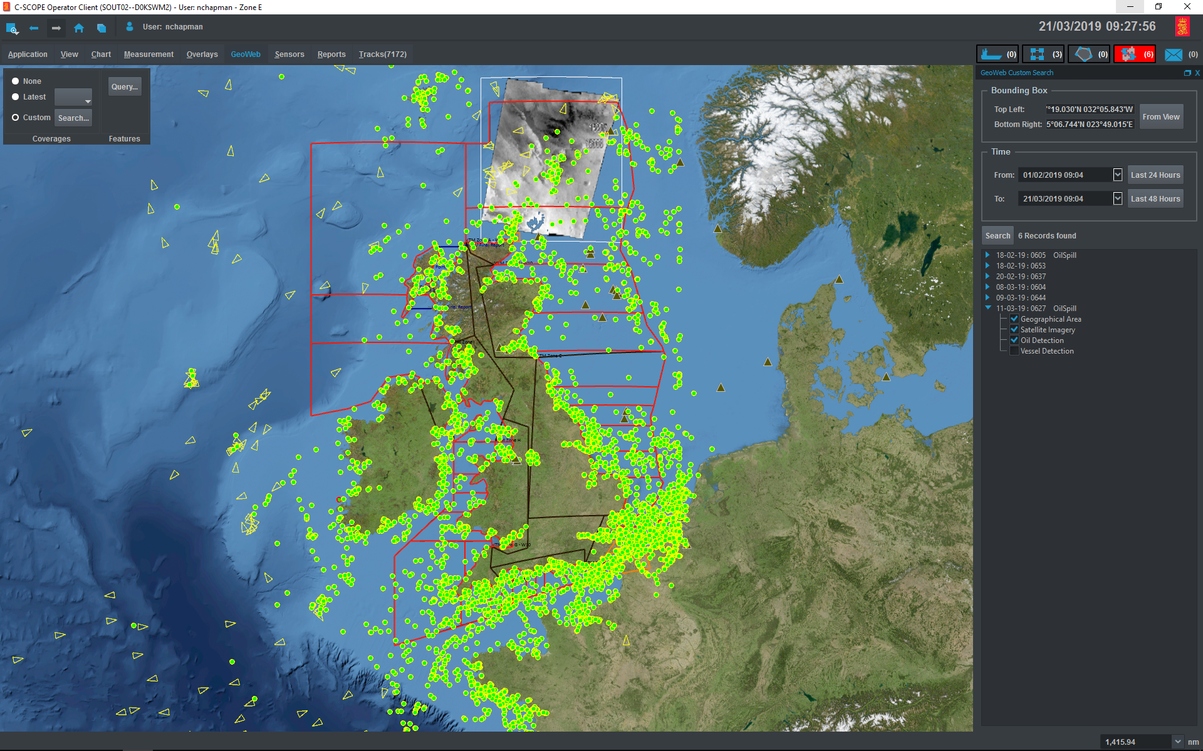
EOS delivered by Kongsberg/KSAT

Slide 45
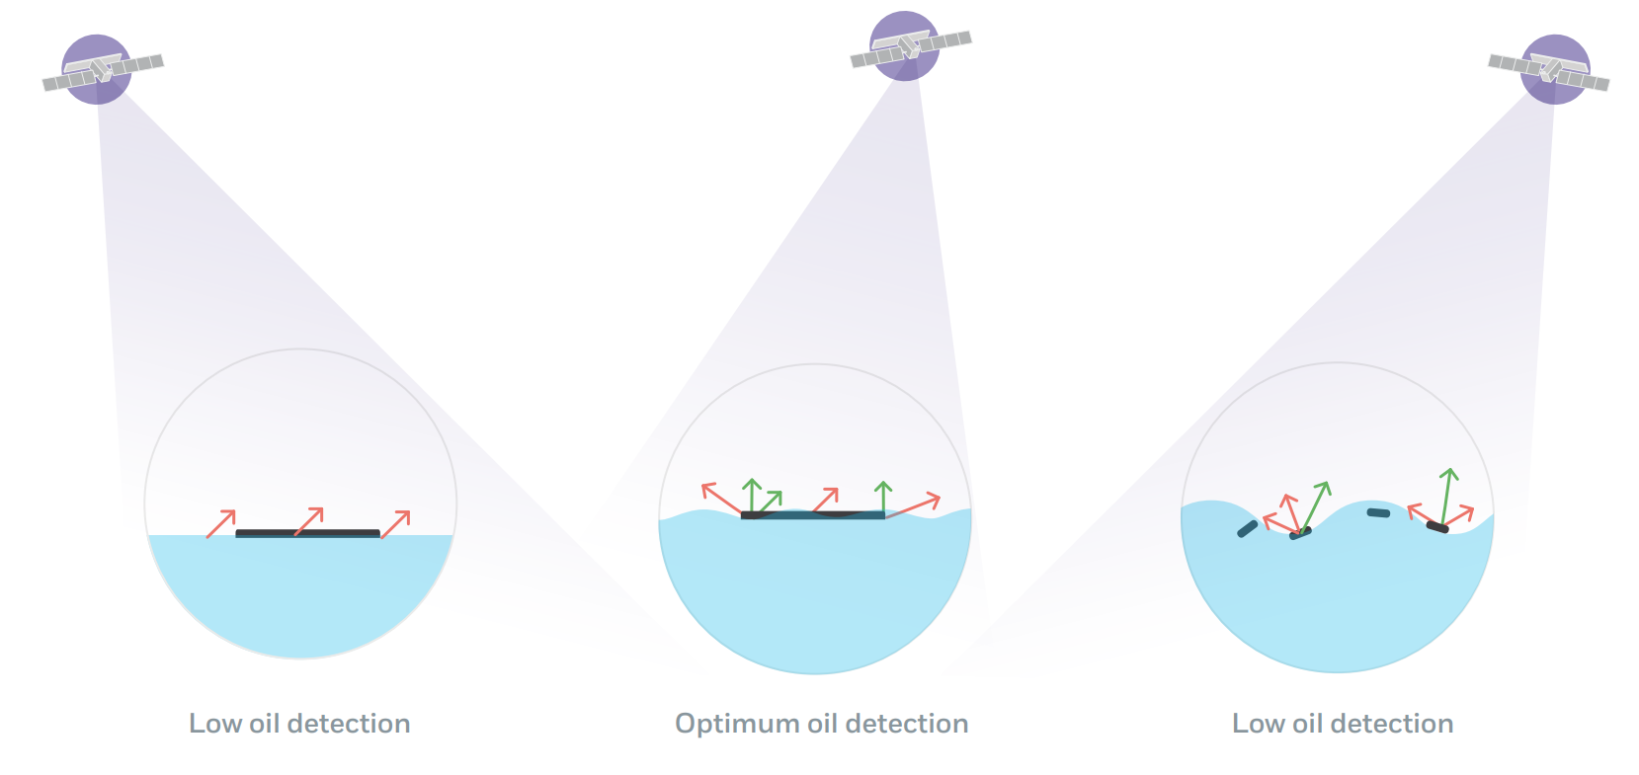
Synthetic Aperture Radar

Slide 46
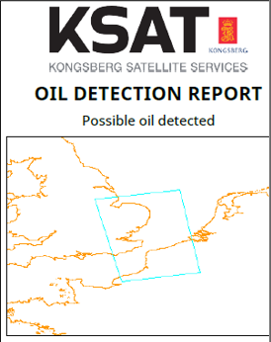
Near Real Time service
CSOC)

Slide 47

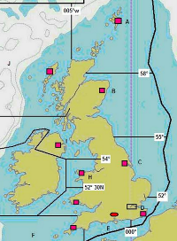
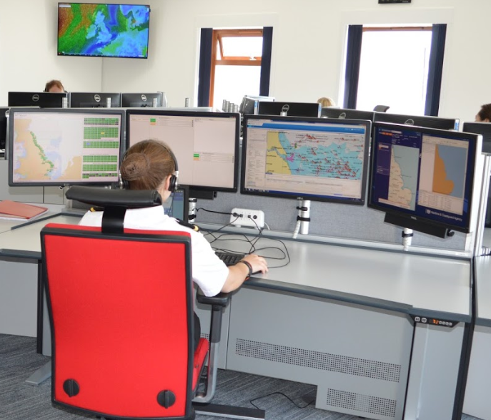
Alert Reports sent to Milford/Humber CGOC
Investigated by nearest CGOC to the ‘hit’
  Contact vessels in vicinity
  Request vessels investigate/report
  Contact Duty CPSO
  Aerial Surveillance

Slide 48
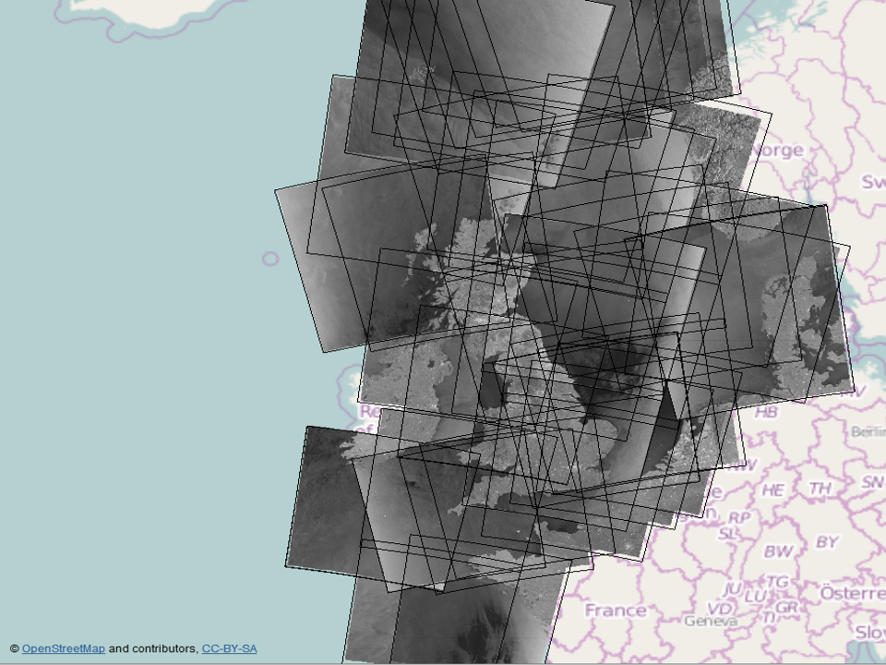
UK EEZ Alert Region
Approx 50-60 Images per month received from EMSA
Images received Near Real Time - within 30 mins of image acquisition.

Slide 49
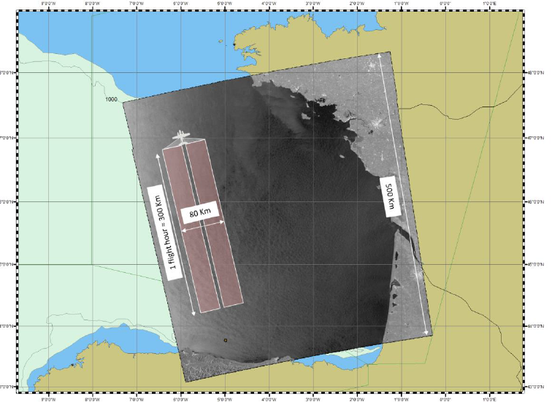
Sentinel-1 images typical 250km x 1000km

Slide 50

Alert report

Slide 51
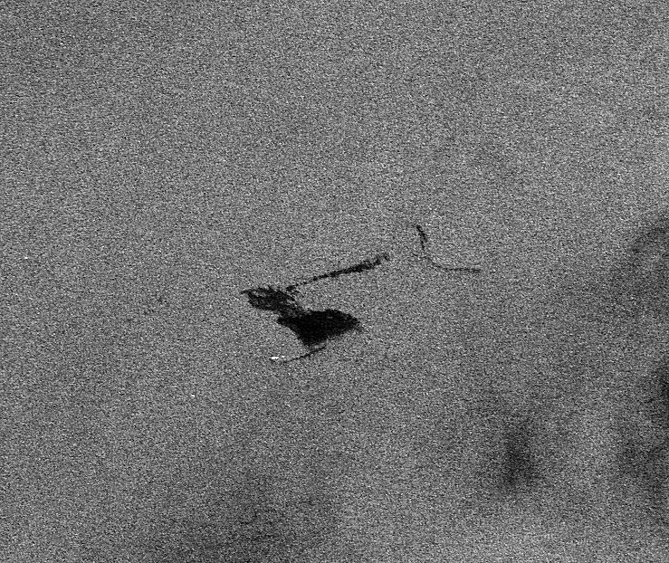
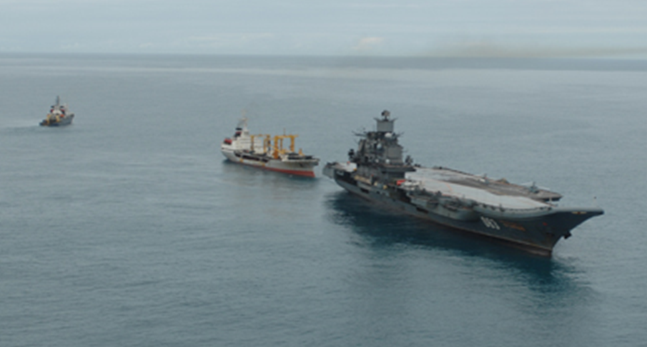
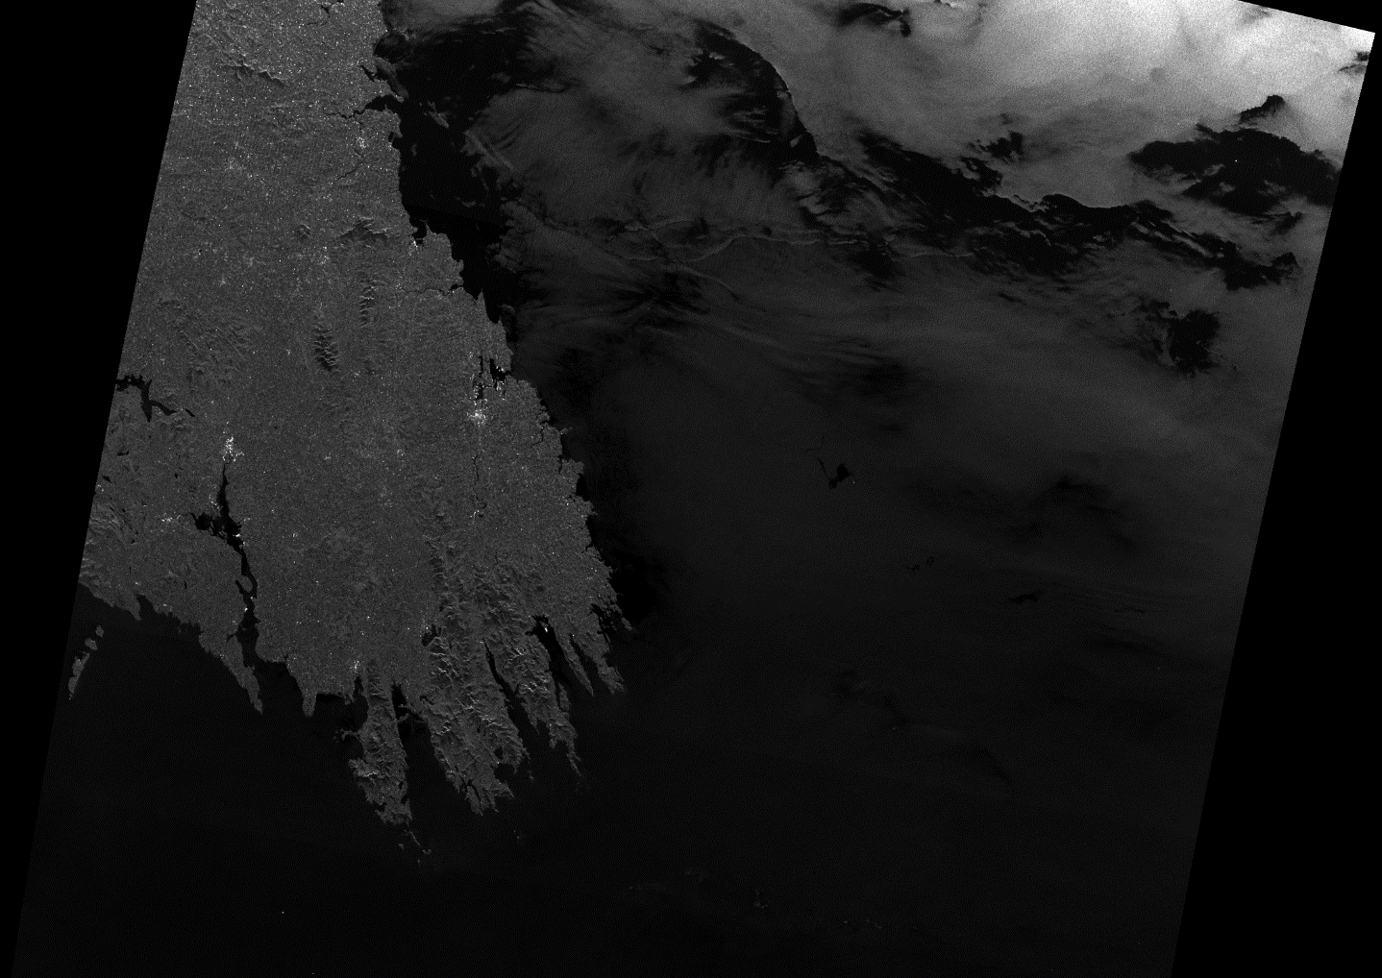
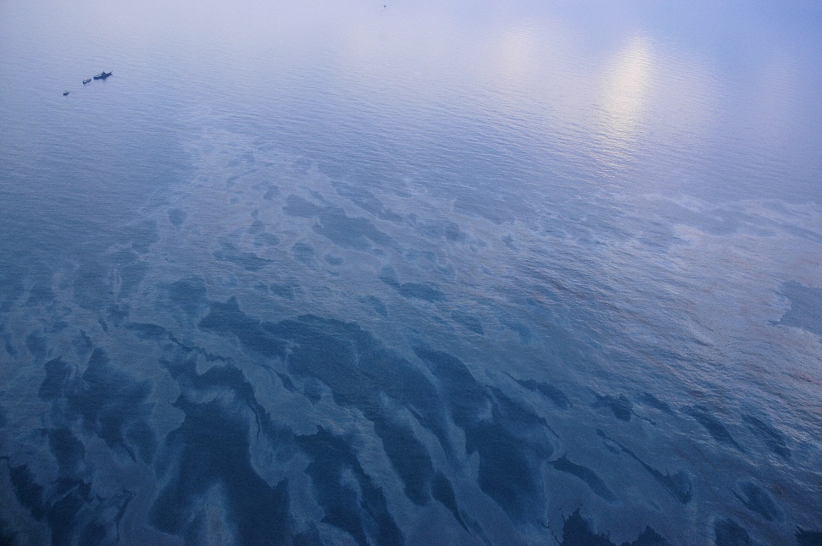
Satellite Surveillance

Slide 52
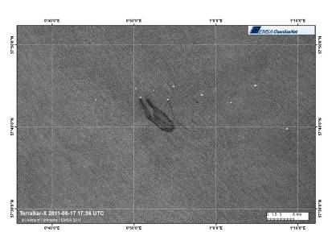
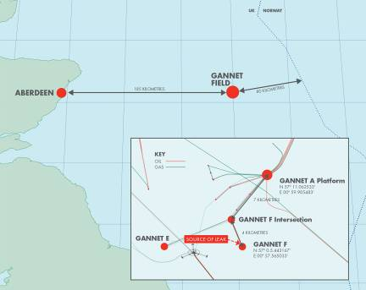
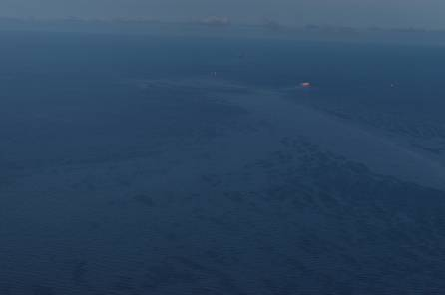
Gannet – Aug 2011

Slide 53
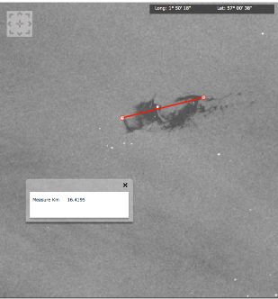
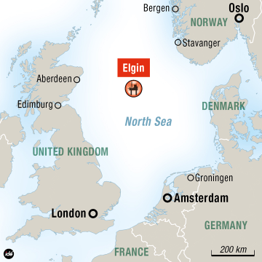
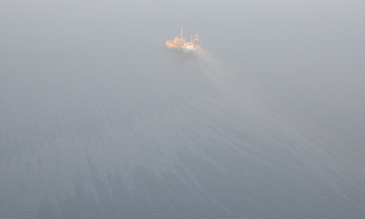
Elgin – March 2012

Slide 54
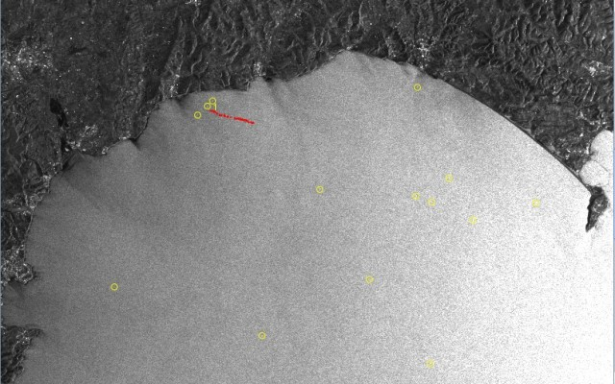
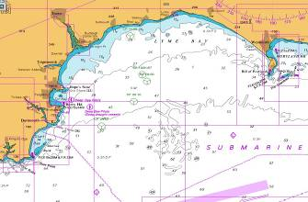
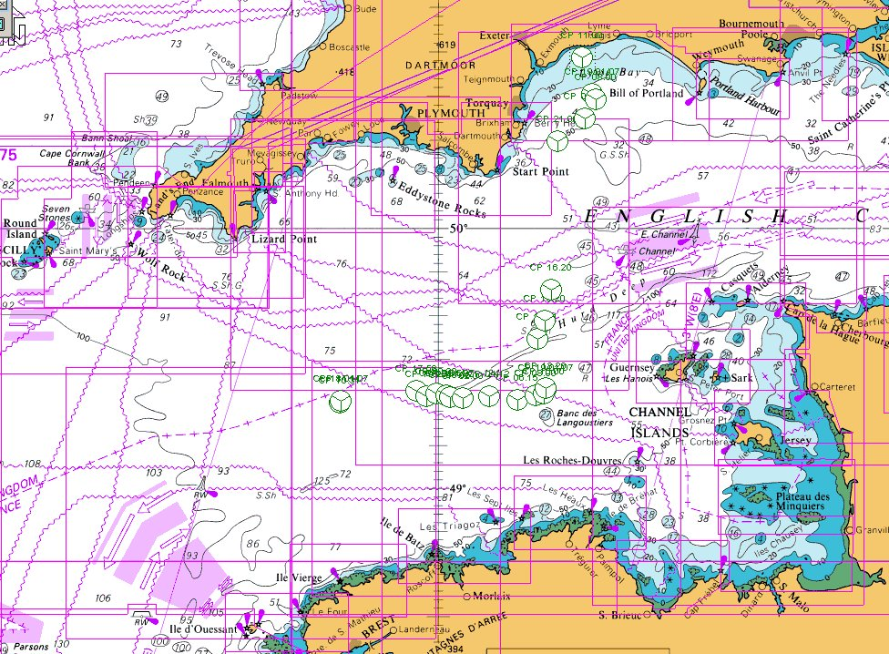
Satellite Surveillance as a deterrent… MSC Napoli

Slide 55
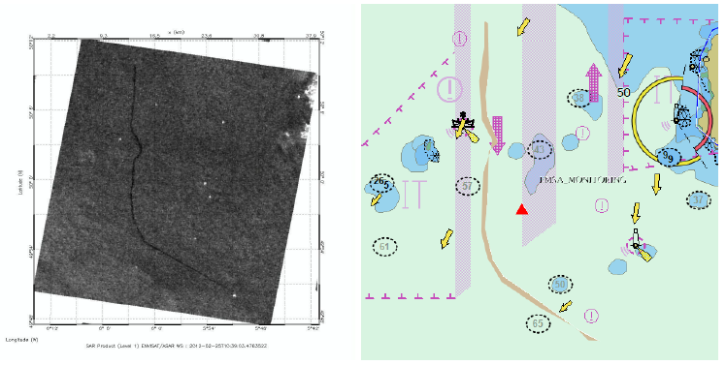
25 February 2012 - Alert

Slide 56
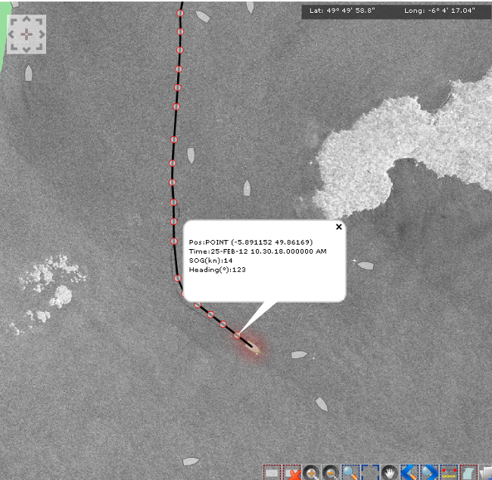

Slide 57
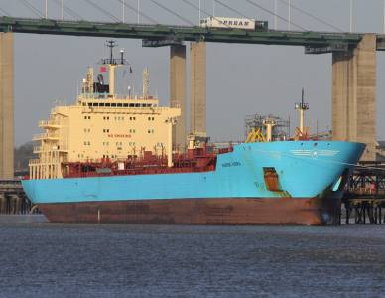
Maersk Kiera
LR/IMO No. 9431305
Gross Tonnage 24,412
MMSI No. 566234000
Year of Build 2011
Travelling between Liverpool and Latvia

Slide 58
Break / Questions

Slide 59
Responding

Slide 60
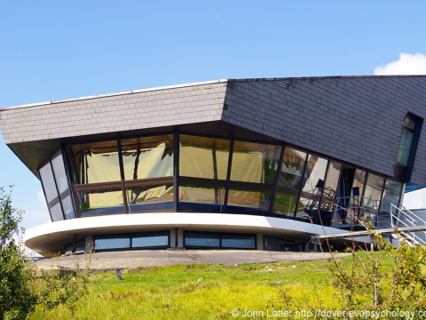
Coastguard Incident Response
Normally first point of contact NMOC / CGOC
Civil Maritime SAR Co-ordination
Vessel Defects / Pollution - gather further information on the potential threat:
  Vessel details
  Hydrocarbons
  Hazardous cargoes
Communications
Alerts the Duty CPSO…….

Slide 61
Role of the MCA Duty CPSO
Front line on-call for pollution response incidents in UK waters.
Make assessment & establishes category of incident & trigger points
Assess initial response actions – are they adequate ?
Assume MCA responsibility for initial Counter Pollution & Salvage implications of incident.
Initial alerting and liaison with internal and external authorities

Slide 62
Duty CPSO
Contacts & Considerations at Incident
DOD
SOSREP
Ship Owners
Environment Agencies
MCA CPS
Deploy Aerial Verification
Pollution Contractors
CPSO
Insurers (eg P&I Clubs)
Tug Companies
& Brokers
Ship Agents
Ports & Harbours
MCA Marine Offices & Marine Casualty Officers
Devolved Administrations
Oil & Gas Operators
BEIS/ OPRED
JRCC / MRCCs
Salvors
MCA Press

Slide 63
Offshore Specific Alerting
SOSREP
OPRED Environmental Management Team (expedite permitting/ consenting issues)
Deploy Aerial Verification
DOD
OPRED Incident Response Controller
Oil Spill Response Contractors
DCPSO
MCA CPS
Coastguard Operations Centre (CGOC)
BEIS – Ensure Security of Oil and Gas Supply
Offshore Operator/Key Contractors (eg Drillers)
BEIS Press
BEIS/OPRED Senior Management/Ministerial Teams/SoS
Environmental Bodies/Agencies
HSE
Relevant Devolved Administrations

Slide 64
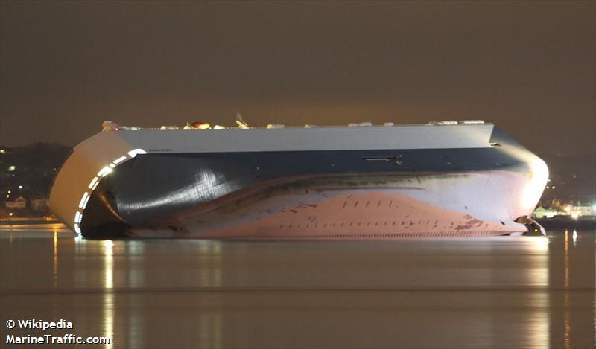

CPSO Initial Deliberations
    Assess initial response:
      Identify responsibility for clean-up
      Establish Lead Responder
      Identify Courses of Action
      Assess adequacy of current response
    Need for Aerial Verification/Surveillance
    Intended response strategy
    Trigger Standing Environment Group
    Alert Ae Spraying capability - 8 hrs
    Task ETV / Seek Commercial towage
    Places of Refuge
    Need for Marine Response Centre (MRC) ?
    MCA Marine Surveyor or other qualified person

Slide 65


International Co-operation
Promulgate POLWARN/POLINFO for Bonn Agreement Parties:
  North Sea States Intergovernmental co-operation dealing with pollution and in particular aerial surveillance co-ordination.
  Activating Bi-Lateral Plans :
    NORBRIT (UK & Norway)
      Agreement between Norway and the UK with
      regards to a joint response, but more focused on
      counter pollution.
      MANCHEPLAN (UK & France)

Slide 66

Fate of Oil - modelling

Slide 67
Incident Management

Slide 68
Potential Response Cells
Shipping Incident
Salvage Control Unit (SCU) - SOSREP
Ports & Harbours Incident Management Cell
Common Response Cells
Marine Response Centre (MRC)
HMCG JRCC / MRCCs
Environment Group
Scientific and Technical Advisory Cell (STAC)
Strategic Co-ordinating Group (SCG)
Tactical Co-ordinating Group (TCG)
Recovery Co-ordinating Group (RCG)
Response Co-ordinating Group (ResCG)
Local Authority (LA )
Or
Devolved Administration Equivalents
Operations Control Unit (OCU) - SOSREP)
Emergency Response Centre (ERC) – Operator
Offshore Incident

Slide 69
Incident Management
Each response cell has primacy within its own domain ie:
Domain Responsibility
Salvage / Offshore containment - SOSREP
At Sea pollution response (Shipping) - MCA
At Sea pollution response (Offshore) - Operator
* MCA MRC monitor as Response Regulator + Resource Support *
On shore pollution response - SCG / TCG / LA
* MCA MRC + Resource Support *
Public Health & Environmental Protection - EG & STAC
Liaison Officers – are vital components

Slide 70
Incident Management
Well Operator / Shipowner
Marine Response Centre
SCG, TCG, RCG etc
Operations / Salvage Control Unit
Environment Group
Collaborative working across response centres -
  No overall incident commander at National (T3) Level
Co-operation and collaboration is essential to a successful response and is only achieved through good communication and a full understanding of the roles and responsibilities of those involved.

Slide 71
Environmental Regulators & Groups / Public Health Bodies /
Scientific and Technical Advisory Cell
Source Control
(SOSREP)
At Sea Response (Maritime and Coastguard Agency)
Shoreline Response (Local Authorities)
UK Parallel Incident Command Structure
Vessel Owner / Insurer / Salvor/ O&G Well Operator

Slide 72

Incident Management

Slide 73

Incident Management

Slide 74

Offshore Incident

Slide 75



MCA CPS -
Marine Response Centre
(MRC)

Slide 76
MRC - Responsibilities
Significant Pollution in UK EEZ – Activate MRC
  Responsible for at sea response inside the EEZ.
  Initially in MCA HQ, may deploy / co-locate.
  Determine the extent of the problem
    Develop Fate of Oil modelling wrt quantity and persistence.
  Determine priorities for action in protecting sensitive areas and dealing with pollution.
  Mobilisation & Prioritisation of national resources

Slide 77
MRC - Responsibilities
  Establish management authority, co-ordination procedures and liaison with:
    Lead Department
    Lead for at-sea response
    Other Cat 1 & 2 Responders
    Establish Joint Communications Centre
  Oversee response operations at sea
    Contractor Response
    Response techniques
    Protection techniques
    Monitoring progress and effectiveness
    MCA has authority to take the lead

Slide 78
MRC Responsibilities
  Surveillance flights and reports
  Dispersant spraying
  Decontamination of at-sea resources
  Logistics
  Cargo transfer operations
  Monitoring of government financial commitments
  Financial security
  management of financial expenditure
  Briefing and Recording – Narrative / Key Decision Making

Slide 79
MRC Composition
Head of Counter Pollution and Salvage Branch, (HoB)
Duty CPSO – initial set-up of MRC / link with SCU/OCU a/r
  Hand-Off to the Room Manager
CPSO - Current Ops,
CPSO - Future Ops planning
Scientific and Tech Support – Lead on Env issues,
Scientific and Tech Support - modelling, satellite imagery.
Resources/Claims Lead + Support Off to manage resources, procurement, national assets, financial governance, etc.

Slide 80
MRC Composition
Liaison Officers:
  HMCG
  Environment Group Liaison Officer
  Operator representative (if Offshore installation)
  Local Authority Liaison Officer:
  Operator and MCA Oil spill Response Contractors (incl Aviation)
  MCA Communications
  Harbour Master (as necessary)
  Fisheries Dept
  any other Coastal State that may be affected
Administration staff

Slide 81
Of course, its not just oil….
Of course, its not just oil….

Slide 82






Slide 83






Slide 84
The Environment Group

Slide 85

UK Standing Environment Groups
The concept of an ENVIRONMENT GROUP (EG), followed a recommendation by Lord Donaldson in his report:
‘Review of Salvage and Intervention and their
Command and Control’

Slide 86
Environment Group (EG)
Functions
Provision of advice to all response units on potential / real impacts to public health and the environment
  SCU, OCU, MRC, SCG/TCG, Local Authorities and Response Contractors.
Assess environmental risk and impact of incident and implemented response measures
Monitor, assess and document public health and environmental impact of an incident and measures implemented in the response
Notes:
The group may be formed for any marine incident, not just when the NCP is activated.
To provide environmental advice and guidance to all response centres involved in response to an oil and or chemical marine pollution incident and subsequent clean up operations. To minimise the impact of the incident on the environment in the widest sense, taking account of risks to public health, the natural environmental and potential impacts arising from any response operations, whether salvage or clean up operations at sea and on the shoreline.
• To monitor, assess and document the public health, environmental and wildlife impact of a maritime pollution incident with respect to oil and/or chemicals and the impact of all measures implemented in response to the incident.
• To facilitate welfare, rehabilitation or humane disposal of wildlife casualties by recognised animal welfare organisations. The advice needs to be clear and concise as well as being suitable for a non-specialist audience.
PREMIAM
EA & CEFAS do joint monitoring.
Collate baseline information of environment before pollution effects it – for cost recovery purposes
Triggered by EG

Slide 87



Environment Group (EG)
Function
Facilitate welfare, rehabilitation or
humane disposal of wildlife casualties
Support Shore Clean-up Assessment
Teams (SCATs)
Site prioritisation
  Advise on relative importance of
  environmental features and wildlife
  Resolution of conflicting issues and priorities
Notes:
The group may be formed for any marine incident, not just when the NCP is activated.
To provide environmental advice and guidance to all response centres involved in response to an oil and or chemical marine pollution incident and subsequent clean up operations. To minimise the impact of the incident on the environment in the widest sense, taking account of risks to public health, the natural environmental and potential impacts arising from any response operations, whether salvage or clean up operations at sea and on the shoreline.
• To monitor, assess and document the public health, environmental and wildlife impact of a maritime pollution incident with respect to oil and/or chemicals and the impact of all measures implemented in response to the incident.
• To facilitate welfare, rehabilitation or humane disposal of wildlife casualties by recognised animal welfare organisations. The advice needs to be clear and concise as well as being suitable for a non-specialist audience.
PREMIAM
EA & CEFAS do joint monitoring.
Collate baseline information of environment before pollution effects it – for cost recovery purposes
Triggered by EG

Slide 88
Environment Group Membership
CORE MEMBERSHIP
  Environmental Regulator
  Statutory Nature Conservation Body
  Fisheries Department
  Public Health Officer
Not just for the big incidents – is dependant upon location,
nature and scale of the incident
  - UK Standing Environment Groups
Other organisations may be invited to join EG
Role is advisory
  EG has no formal powers (although it individual members may have)

Slide 89

UK Standing Environment Groups

Slide 90

MCA
Core
+ public health
+ local authorities
+ local knowledge
+ BEIS, MSS, Operators
+ any necessary other
Core
+ public health
+ local authorities
+ local knowledge
EA/SEPA;
MMO/MS;
NE/SNH/JNCC
Local
Regional
National
‘standing EG’
‘operational EGs’

Slide 91

QUESTIONS
AFTER 50,000 GALLONS OF WHISKY
LEAKED INTO THE SEA, NO TERN
WAS LEFT UNSTONED

